Slide 1
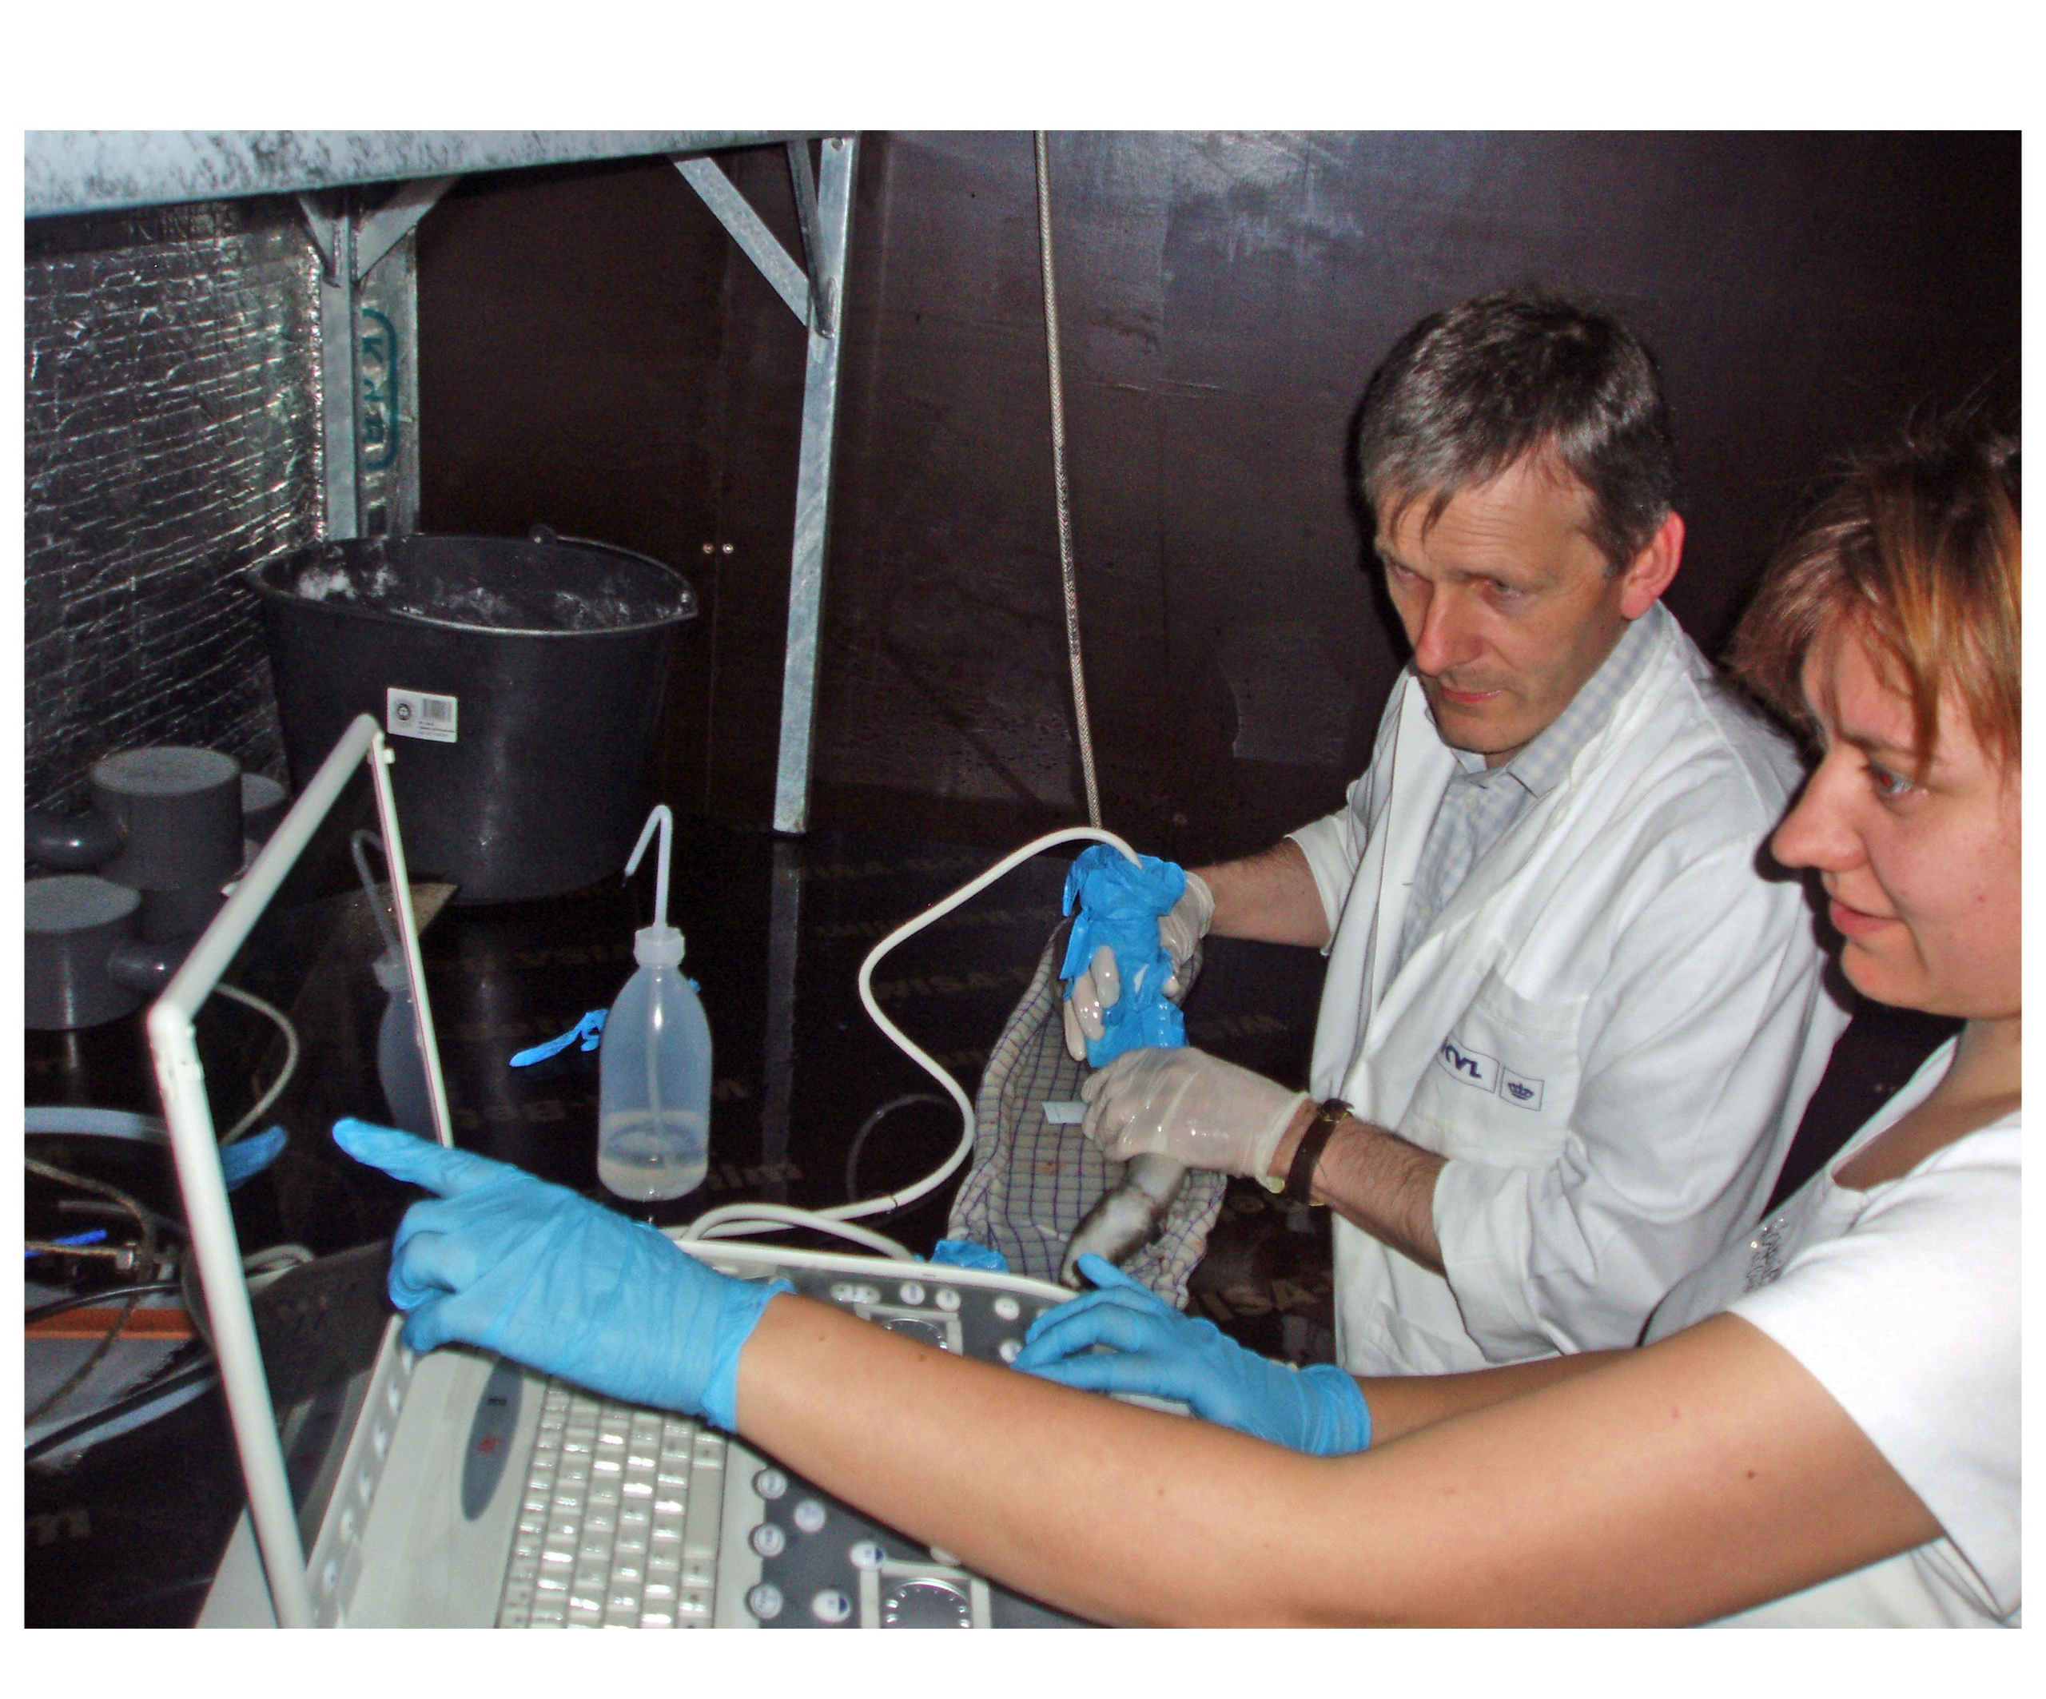
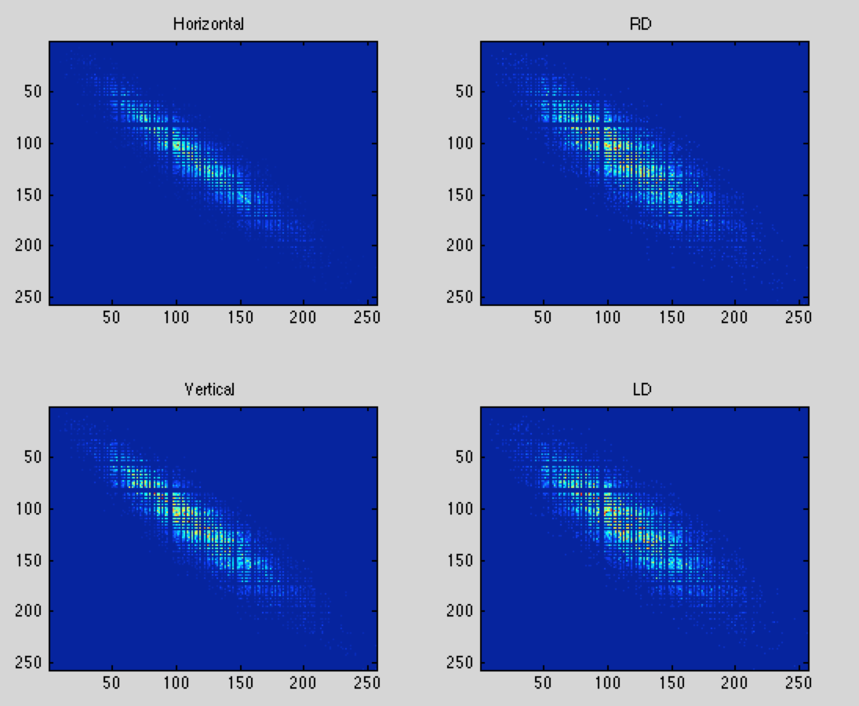
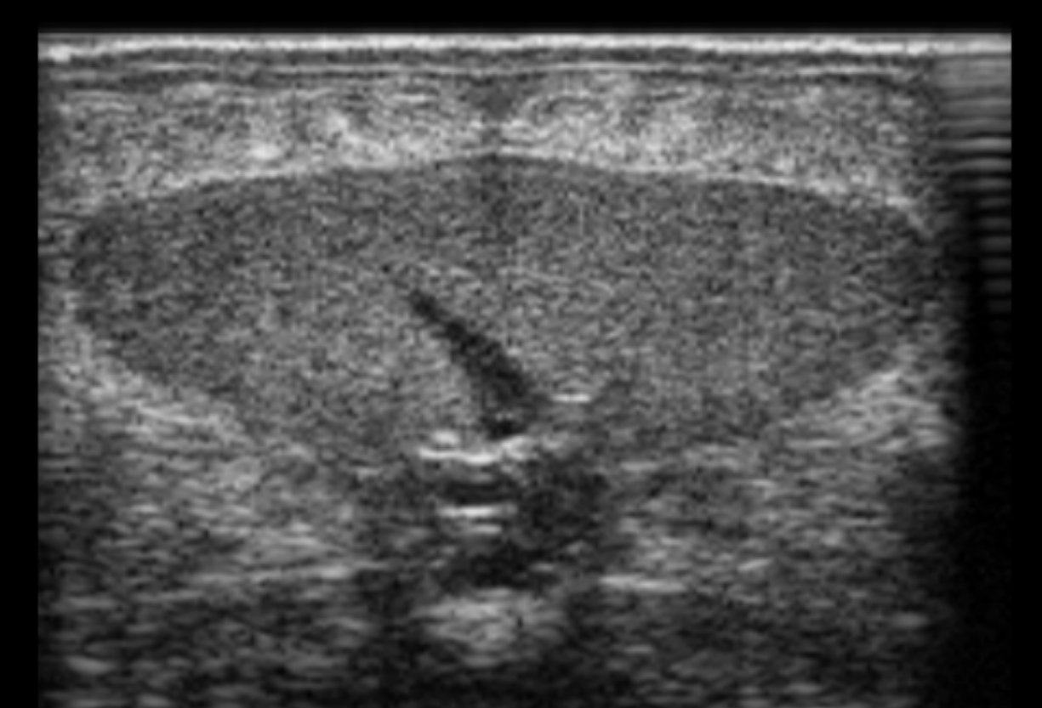
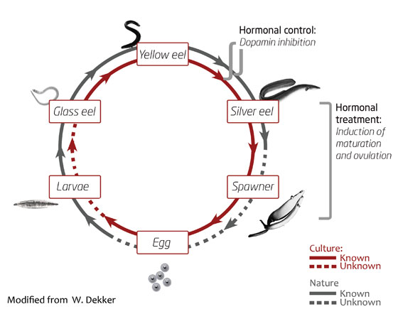
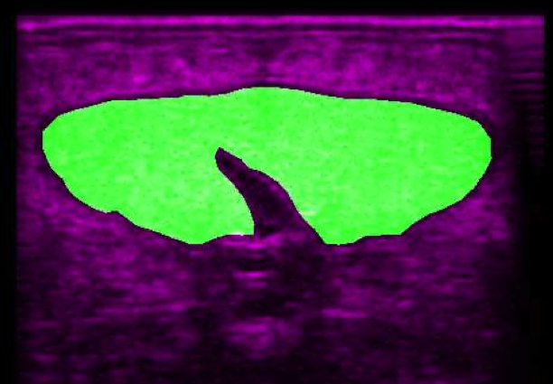


DEPARTMENT OF VETERINARY CLINICAL AND ANIMAL SCIENCES
UNIVERSITY OF COPENHAGEN
Using ultrasound in monitoring induced ovarian maturation
in the European eel (Anguilla anguilla)
Anna V. Müller¹, José M. Amigo², Fintan J. McEvoy³, Sebastian N. Politis⁴, Jonna Tomkiewicz⁵
Corresponding author: Anna V. Müller, avm@sund.ku.dk, phone +45 35 33 09 44.
^{1,3}Department of Veterinary Clinical and Animal Sciences, Faculty of Health and Medical Sciences, University of Copenhagen, Frederiksberg, Denmark
²Department of Food Science, Quality and Technology, Faculty of Science, University of Copenhagen, Frederiksberg, Denmark
^{4,5}National Institute of Aquatic Resources, Technical University of Denmark, Charlottenlund, Denmark
The long-term aim of this study is to fully understand the reproductive capacity of the species in captivity.
Materials and methods
Population
83 eels treated with salmon pituitary extract to induce ovarian maturation
Ultrasound scans
At week 7 and week 11
Texture analysis
Gray-level co-ocurrence matrices^{ab} Principal Component Analysis (PCA)
Classifcation
Based on histology of ovaries:
Non, slow or fast responder
Main target
The European eel (Anguilla anguilla) is an endangered species. Eels have a highly complex life cycle, and they do not breed in captivity. The main problems in captive eel reproduction include poor responsiveness to hormonal treatment, limiting egg production, quality and embryonic developmental competence.
Figure 2. Sampling. Ultrasound images were recorded using a portable ultrasound machine coupled with a 18 MHz transducer.
Figure 3. Original ultrasound image of an ovary from Anguilla anguilla.
Figure 5. Gray-level co-occurrence matrices for the region of interest in figure 4.
Figure 4. Segmentation of image from figure 3. The area of interest is shown in green.
Results
It was possible to identify the ovaries and measure the cross-sectional area in all of the eels.
Texture is clearly associated to increasing size, which represents response to treatment.
The first three Principal Components explain 78,44 per cent of the variation in texture analysis of images from the later scan, i.e. at 11 weeks of therapy.
Figure 1. The life cycle of A. Anguilla. There is an urging need for a sustainable eel production, including captive reproduction of the European eel. Image from www.pro-eel.eu.
Information available from ultrasound images includes tissue area, volume and texture. Texture analysis refers to the quantification of image features perceived as textural to the observer.
Texture analysis is widely used in medical imaging and is performed in two main steps:
Calculation of several textural attributes that describe the texture numerically
Use of the computed texture features to train and evaluate a classifier
Figure 6. Principal Component Analysis. The cross-sectional area is indicated by color. Dark blue represents the smallest size, red is the largest. Area is clearly affecting the texture.
Conclusion
Ultrasound is an efficient tool in monitoring the size of the ovaries in A. anguilla.
The ovarian texture is not significantly different between different groups at an early stage of treatment.
References cited
ª Gotlieb, C. C. and H. E. Kreyszig (1990). "Texture Descriptors Based on Co-occurrence Matrices." Computer Vision, Graphics, and Image Processing 51: 70-86.
^{b} Haralick, R. M., et al. (1973). "Textural Features for Image Classification." IEEE Transactions on Systems, Man and Cybernetics SCM-3(6): 610-621.
DTU May 14 2014
www.pro-eel.eu

